Slide 1

Food Trends: Understanding Customer Preferences Through Data
INFOSYS SPRINGBOARD INTERNSHIP 6.0
Presenter: Sam Joseph | Team: Group - 1, Batch – 11
Mentor: NityaShree J

Slide 2

CHAPTER 1
Project Objectives
1
2
3
Market Trend Analysis
Customer Sentiment
Price-Value Correlation
Evaluating cuisine popularity, global reach, and restaurant chain dominance across various cities to pinpoint emerging trends.
Measuring satisfaction and loyalty through rigorous analysis of ratings and voting patterns to understand the customer voice.
Investigating how pricing models affect customer perception and behavioral trends, optimizing value for both customers and businesses.
4
5
Service Logistics
Strategic Optimization
Assessing the operational impact of online delivery availability versus table booking options to streamline service efficiency.
Transforming raw data into actionable recommendations to improve quality, reduce risk, and drive informed business decisions.
1

Slide 3
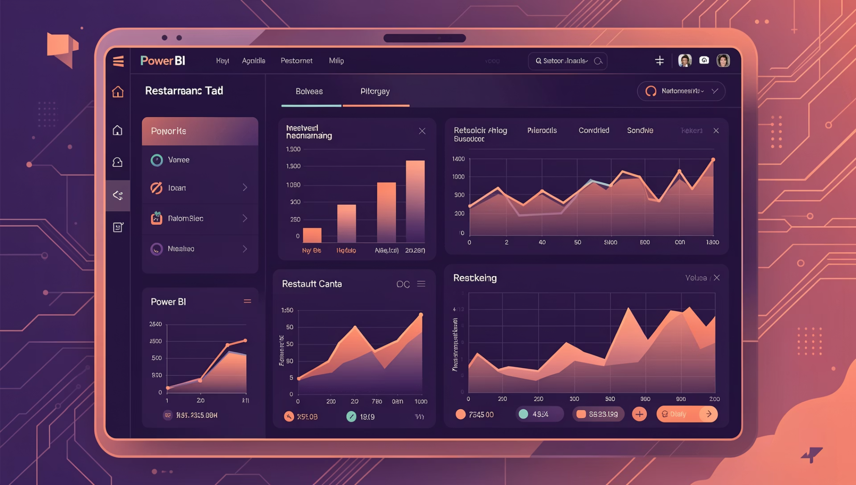
CHAPTER 2
Project Overview: From Data to Decision
Scope of Analysis
Our project involved a comprehensive examination of global market patterns, exploring the intricate relationships between cuisine demand, pricing strategies, and service availability across various regions. We aimed to provide a holistic view of the food industry landscape.
Methodology
We utilized interactive Power BI dashboards to convert complex, raw restaurant data into compelling visual narratives. This approach empowered stakeholders to effortlessly glean insights and make evidence-based decisions, moving beyond intuition to data-driven strategy.
2

Slide 4
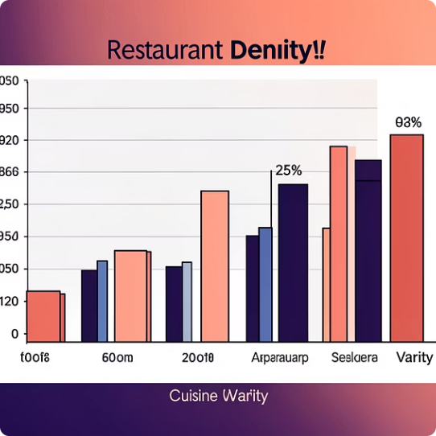
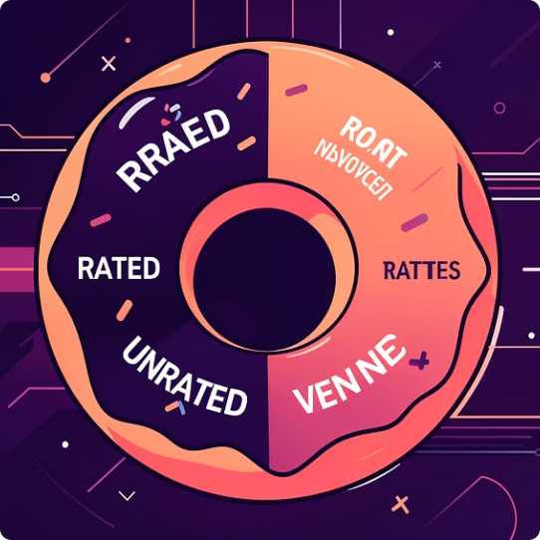
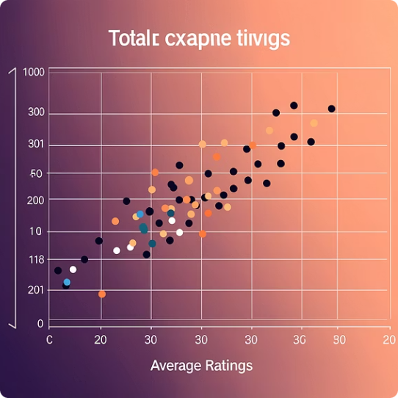
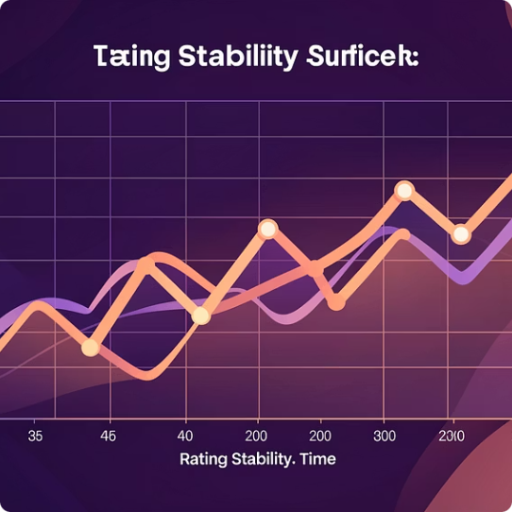
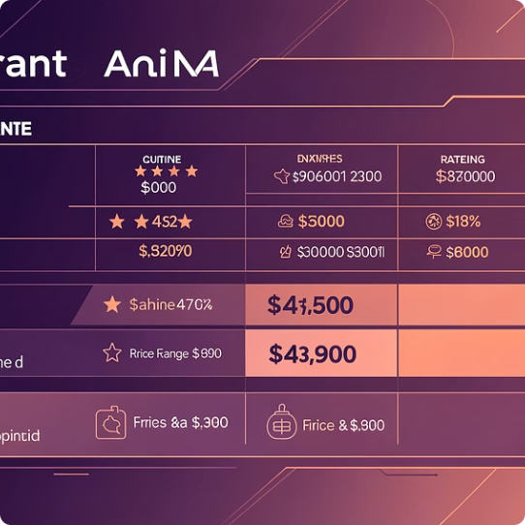
CHAPTER 3
Key Visualizations & Analytical Tools in Power BI
Our dashboards leverage a diverse set of visualization techniques to ensure clarity and actionable insights from complex datasets.
Bar Charts
Donut Chart
Scatter Plots
Line Charts
Used for comparing restaurant density, cuisine variety, and city-wise performance.
Visualized the distribution of rated vs. unrated venues and online delivery penetration.
Mapped the correlation between total votes and average ratings to detect anomalies.
Tracked rating stability across different vote "buckets" for reliability.
Tabular Data
3
Provided granular, restaurant-level details for drill-down analysis.

Slide 5
CHAPTER 5
Challenges & Innovative Solutions
Facing common data analysis hurdles, we implemented creative solutions to ensure accuracy and usability of our Power BI dashboards.
Normalizing Costs Across Currencies
Challenge: Varied international currencies presented a challenge in standardizing financial data.
Solution: Implemented interactive slicers, allowing dynamic currency conversion and viewing for global comparison.
Meaningful Segmentation for Votes/Ratings
Challenge: Raw ratings data lacked context for deeper analysis.
Solution: Applied advanced DAX logic to categorize data into structured "buckets" (e.g., highly rated, moderately rated) for clearer insights.
Ensuring Dashboard Uniqueness & Relevance
Challenge: Avoiding redundant or generic dashboard views.
Solution: Each view was meticulously designed with a specific, distinct business objective, maximizing relevance and actionability.
Preventing Data Clutter
Challenge: Overwhelming users with too much information.
Solution: Prioritized storytelling and key metrics over raw number dumps, focusing on digestible, impactful insights.
5

Slide 6

CHAPTER 6
Technical Skills Acquired & Applied
Data Engineering
Advanced Analytics
Mastery of Power Query for efficient data sourcing, cleaning, and Extract, Transform, Load (ETL) processes, ensuring data integrity.
Proficiently utilizing DAX (Data Analysis Expressions) for creating complex calculated measures and columns, deriving deeper insights.
UX/UI Design
Strategic Analysis
Building intuitive and interactive Power BI dashboards featuring cross-filtering, slicers, and drill-down capabilities for enhanced user experience.
Developing robust frameworks for risk detection, understanding consumer behavior interpretation, and informing strategic business decisions.
6

Slide 7

Project Milestones
Milestone 1
Milestone 2
Milestone 3
Milestone 4
Data Collection & Understanding
Data Analysis & Trend Identification
Visualization & Dashboard Creation
Insights & Recommendations
Collected Zomato Restaurants Dataset from Kaggle Studied dataset structure, features, and data quality Dashboard 1: Dataset overview & basic statistics
Handled missing and inconsistent values Standardized cuisine, rating, and cost fields Dashboards 2–3: Cleaned data validation & category distribution
Analyzed ratings, cuisines, cost, and delivery options Identified patterns using charts and filters Dashboards 4–6: Ratings analysis, cuisine trends, cost vs rating
Extracted key insights from dashboards
Prepared conclusions and project documentation Dashboard 7: Final insights & summary dashboard

Slide 8
CHAPTER 7
Key Insights Discovered: What the Data Tells Us
Reliability Metric
The Premium Advantage
Restaurants with higher vote volumes consistently display significantly more stable and reliable ratings, indicating established customer trust.
Higher-priced establishments consistently secure better customer ratings, suggesting a strong positive correlation between price and perceived quality.
Digital Reach
The Visibility Gap
The availability of online delivery services is a primary driver for increased customer engagement and broader accessibility, expanding market reach.
A notable segment of high-quality restaurants suffers from low visibility, presenting a clear and actionable marketing opportunity for targeted promotion.
7

Slide 9
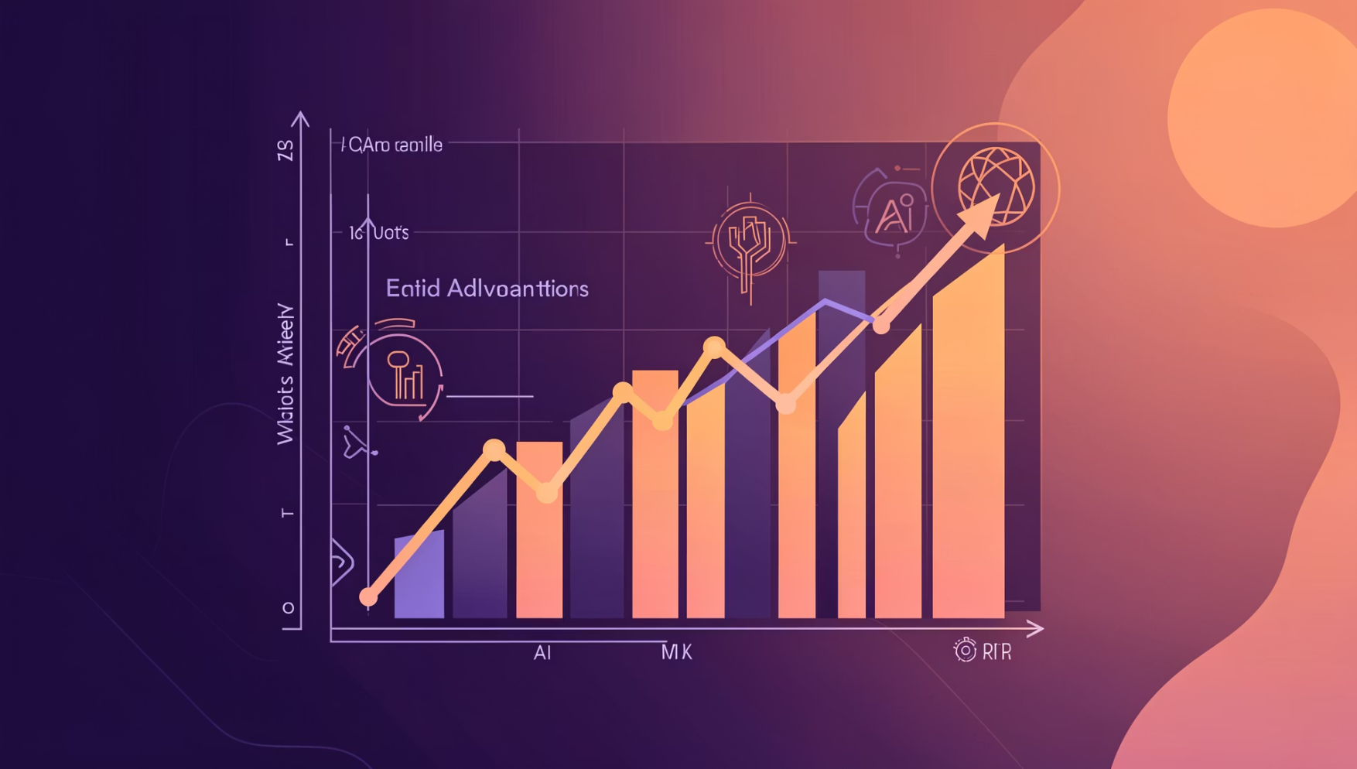
CHAPTER 8
Future Roadmap & Conclusion: Beyond the Dashboard
Future Directions
Sentiment Mining: Implementing Natural Language Processing (NLP) to extract emotional context from textual customer reviews.
Temporal Analysis: Studying seasonal trends and time-series data to predict peak times and shifting food preferences.
Predictive Analytics: Deploying machine learning algorithms to forecast future restaurant performance and market shifts.
Impact Summary
This project successfully transforms raw data into a 360-degree view of market dynamics, identifying clear growth opportunities and robust risk mitigation strategies for the food industry.
8

Slide 10

Future Enhancements
Integrate Real-Time Data Sources
Leverage Advanced Analytics & AI
Time-Based Trends
Analyze seasonal and temporal patterns in food preferences
Incorporate real-time data feeds from various channels to capture evolving customer preferences and trends in a timely manner.
Apply machine learning models and artificial intelligence techniques to uncover deeper insights and predictive patterns from the data.

Slide 11
CONCLUSION
The Infosys_Food Trends project leveraged large-scale restaurant datasets to decode complex consumer behaviors. By implementing rigorous data preprocessing and exploratory data analysis (EDA), I identified critical trends in cuisine demand, pricing elasticity, and geographic market shifts. The resulting interactive dashboards provide a strategic framework for data-driven decision-making, enabling stakeholders to optimize service offerings based on quality, affordability, and logistics.
9
9

Slide 12

CHAPTER 9
Acknowledgements
Our gratitude to those who supported and guided this insightful internship journey.
Infosys Springboard Team
NityaShree J
For providing an invaluable platform and professional growth opportunity.
For expert guidance, constructive feedback, and dedicated technical mentorship.
Team C
References
Microsoft Power BI Documentation, kaggle
.
10

Slide 13


